Slide 1


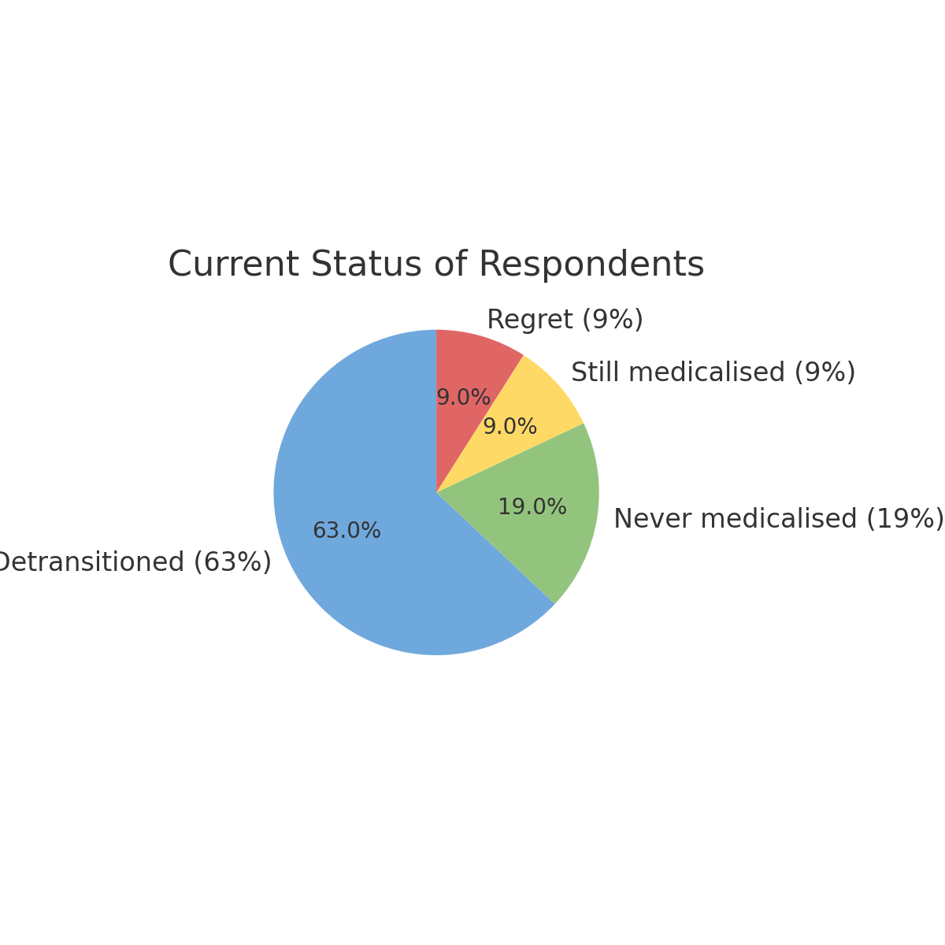
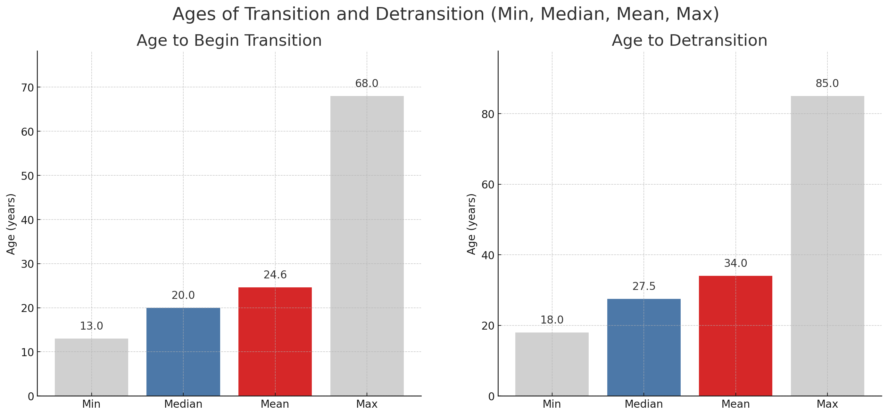
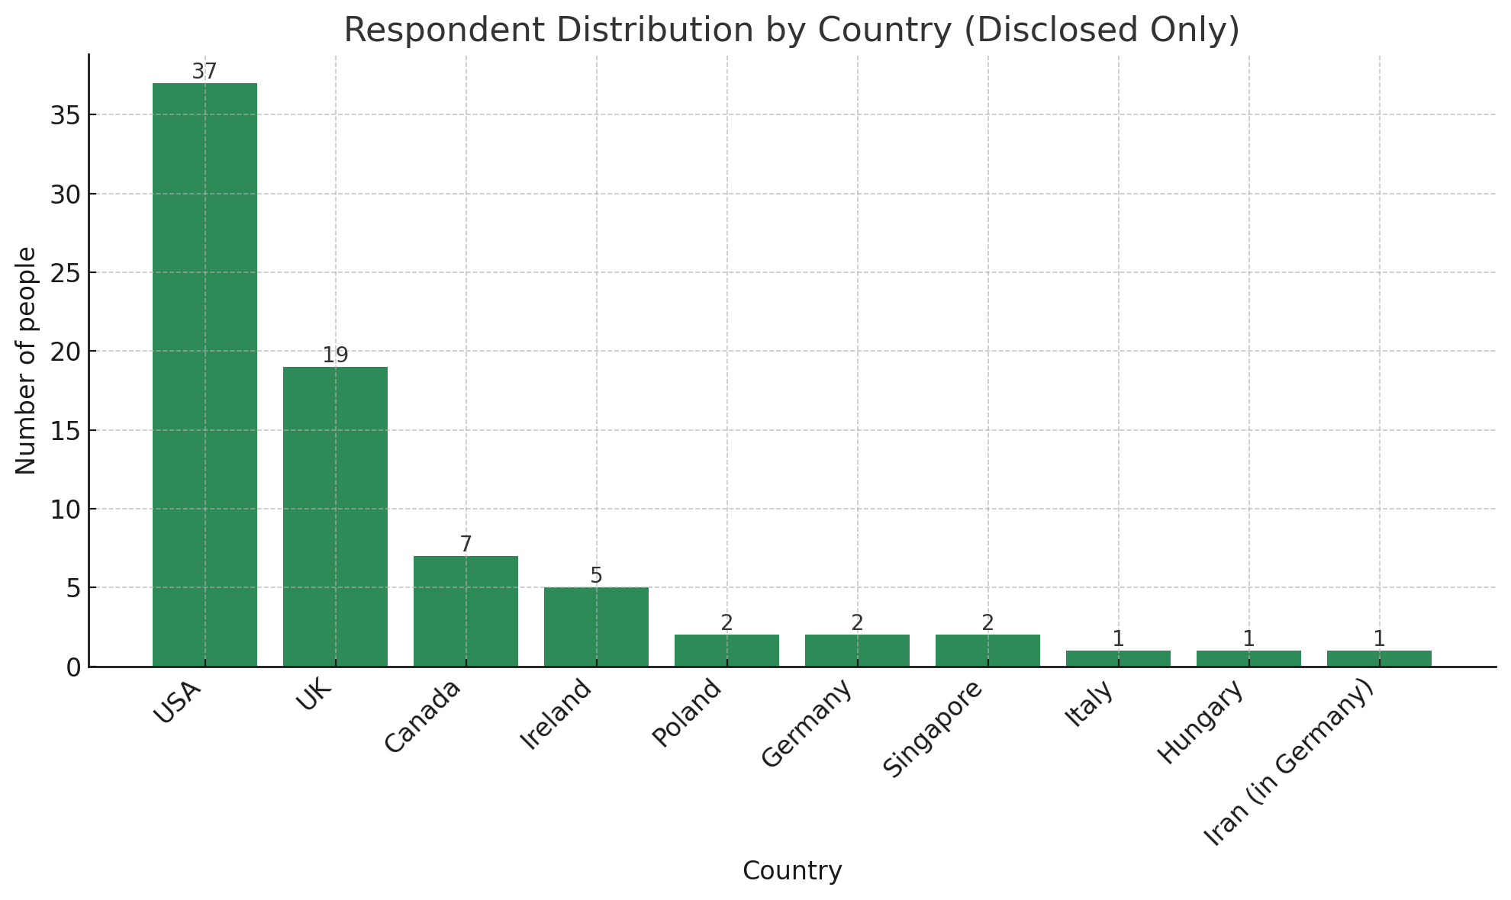
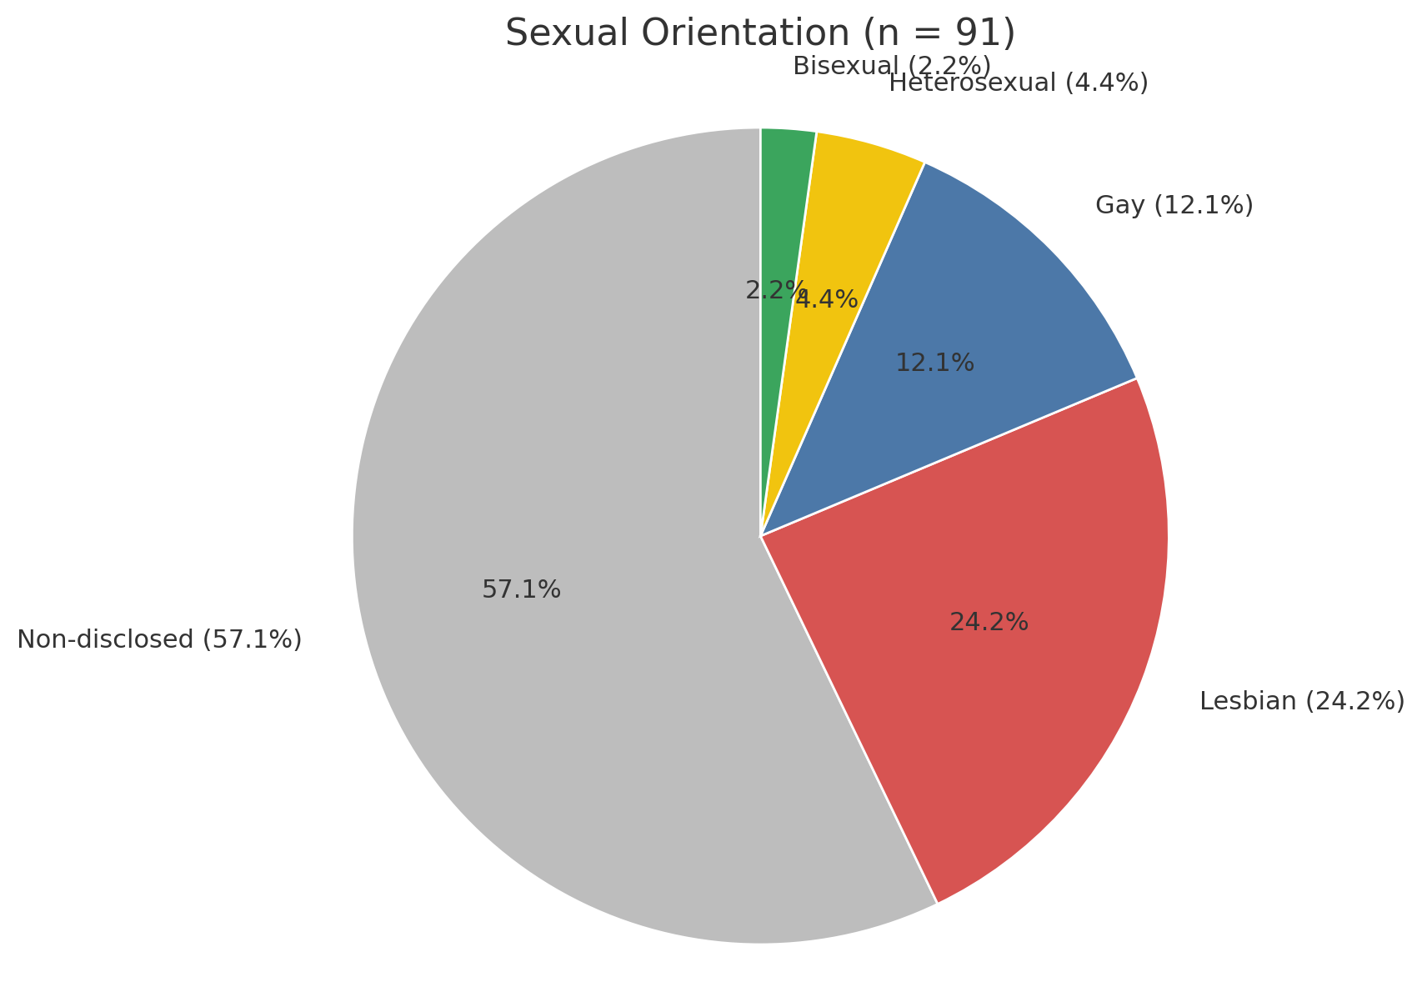
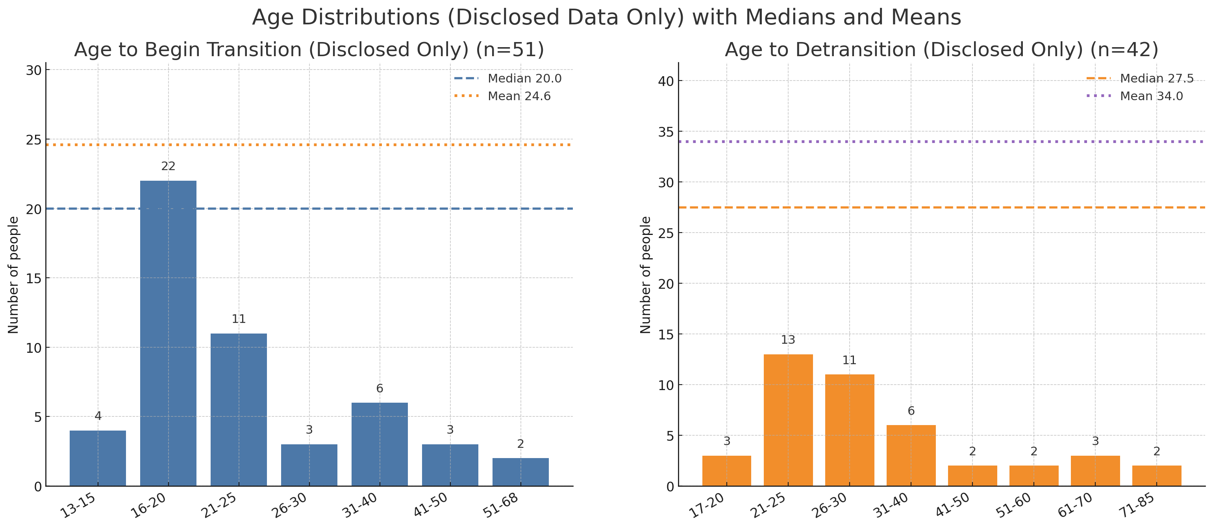
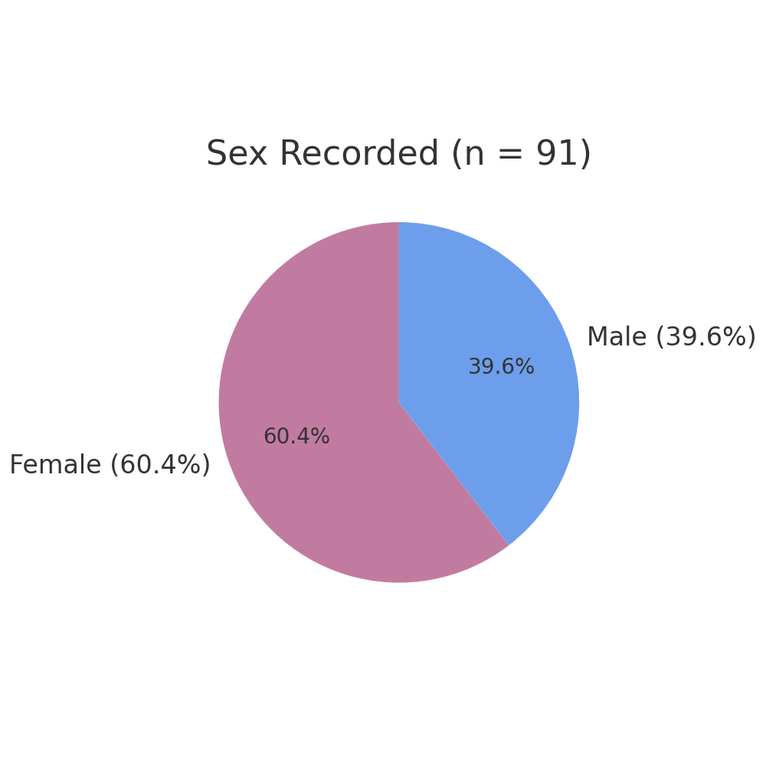
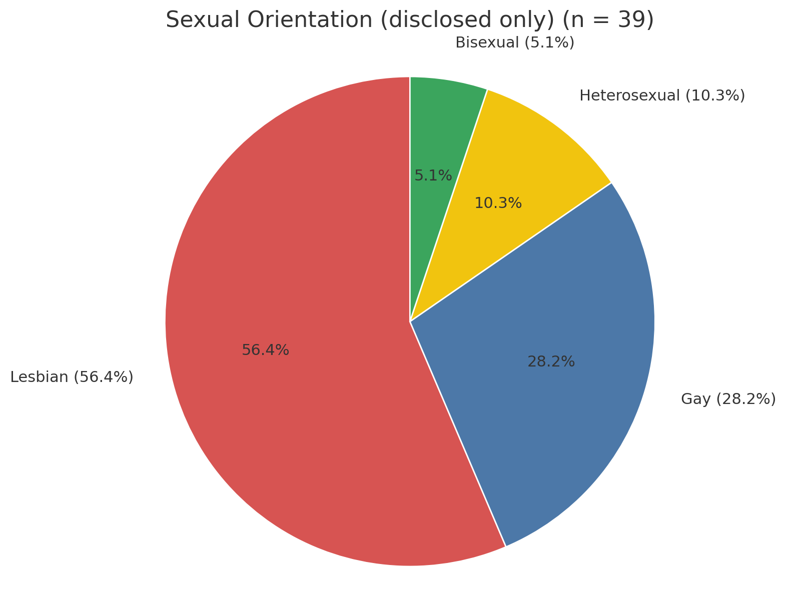
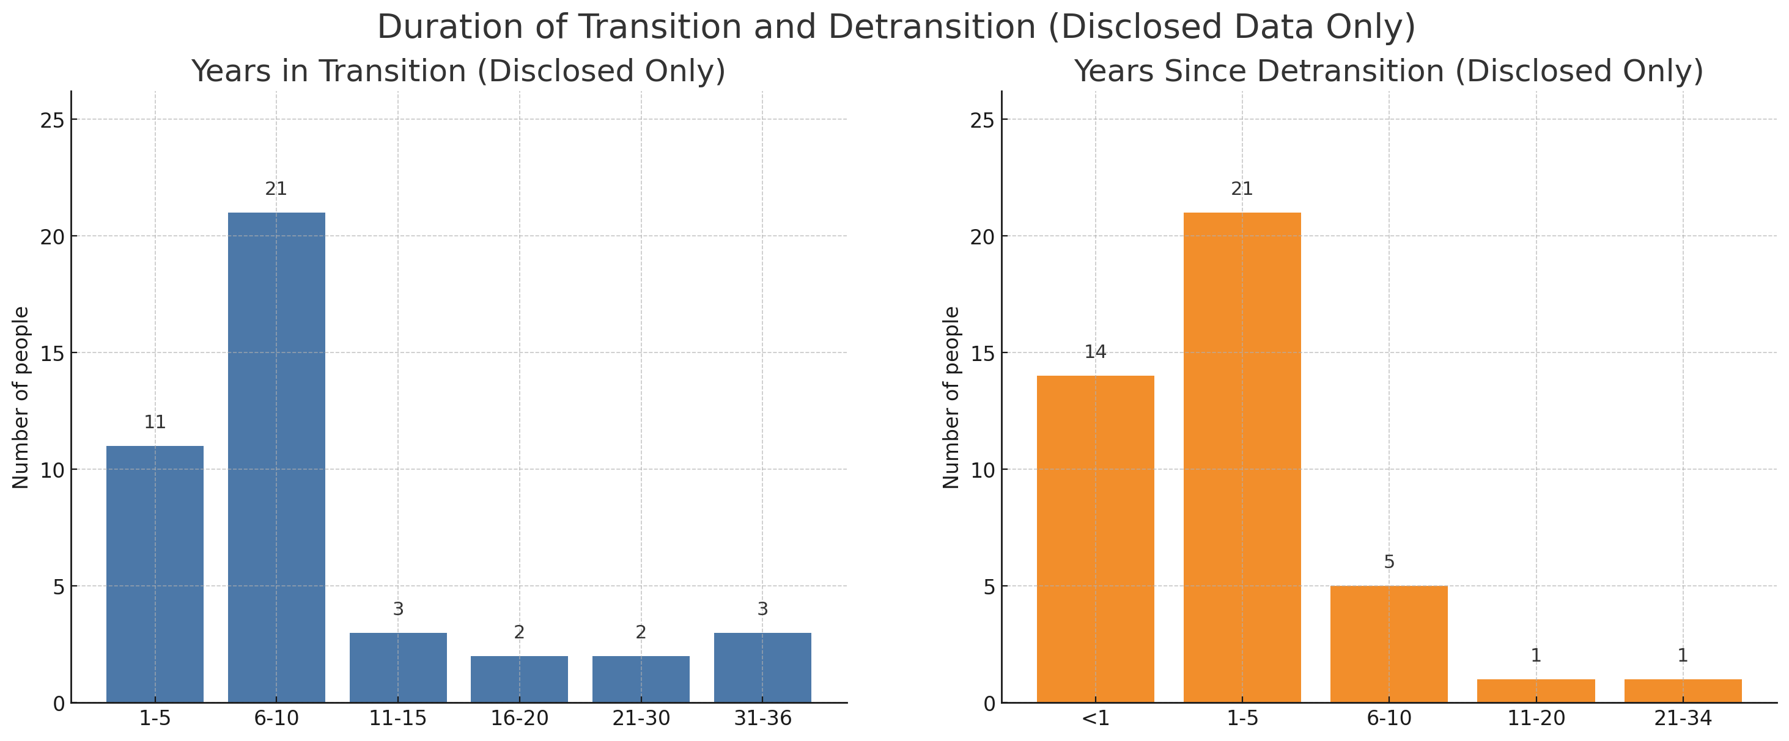
Beyond Trans: Therapist-Facilitated Group Support — Participant Profile & Outcomes
Stella O’Malley
Founding Director of Genspect and Beyond Trans; member, Killarney Group Think Tank
Background & Services
Participants — Current Status
Transition & Detransition
  Beyond Trans launched June 2022 within Genspect.
  Therapist-facilitated, free online group support; 3–4 groups weekly; typical size 10–15.
  Directory of well-informed therapists.
  Advocacy and resources for detransitioners.
Transition & Detransition (summary)
Age at start of medical transition (n=51): Median 20.0; Mean 24.6; Range 13–68 years.
Years in transition (n=42): Median 6.0; Mean 9.0; Range 1–36 years.
Age at detransition (n=42): Median 27.5; Mean 34.0; Range 18–85 years.
Years since detransition (n=42): Median 1.5; Mean 3.1; Range 0–34 years.
Program Scale
Participants — Current Status
  • 63% stopped medical transition
  • ~9% regret medicalisation
  • ~9% remain medicalised (often ambivalent)
  • ~19% never medicalised
>480
3–4 meetings/week
Service users to date
10-15 participants/meeting
Online group meetings held
Specialised meetings
Typical cadence
Detrans Only; Open Group; Female Only; Adult Transitioners; Child Transitioners
Geography
Participants — Sexual Orientation
Figure 5. Age at start & at detransition — summary statistics.
Figure 1. Geographic distribution of participants.
Participants — Sex
Figure 3. Sexual orientation (including non-disclosures).
Figure 6. Distribution of ages.
Figure 2. Sex distribution of participants (since Jan 2025).
Participant Quotes
Participant Quotes — Isolation & Understanding
  • “My life was on hold when I was living in transition.”
  • “My body wants to have been left alone.”
  • “It’s taboo to be negative about trans, but it ruined my life.”
  • “I outsourced my autonomy and authority to my therapist.”
  • “They rolled out the red carpet for me when I transitioned.”
Co-morbidities & Traumas
  • Autism • ADHD • Eating disorders • Bipolar • OCD • Depression • Anxiety
  • Schizophrenia • Sexual assault/rape • Childhood sexual abuse • PCOS
  • Alcoholism • Substance use • Body Dysmorphia
Figure 4. Sexual orientation (excluding non-disclosures).
Participants — Current Status
Figure 7. Years in transition.
Contact: genspect.org • beyondtrans.org • Beyond Trans groups are provided free of charge; therapists and volunteers welcome.
Figure 4. Current status of participants.

